Slide 1
SATURDAY
What I am doing at Saturday?

Slide 2
MORNING
I get up at six o clock , I get dressed and go in the stable at seven o clock.
When I finish in the stable I need to give animals food and water.
When I finish I go eat something for breakfast, then I find my self something for work.

Slide 3
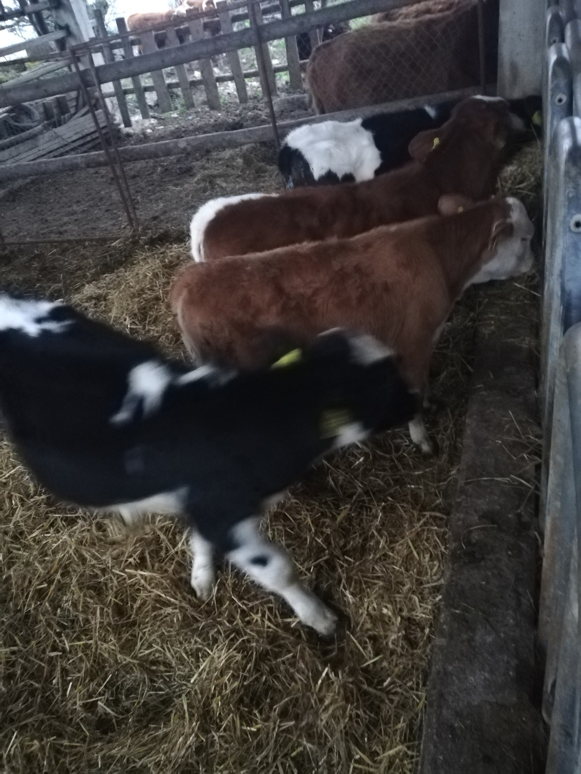
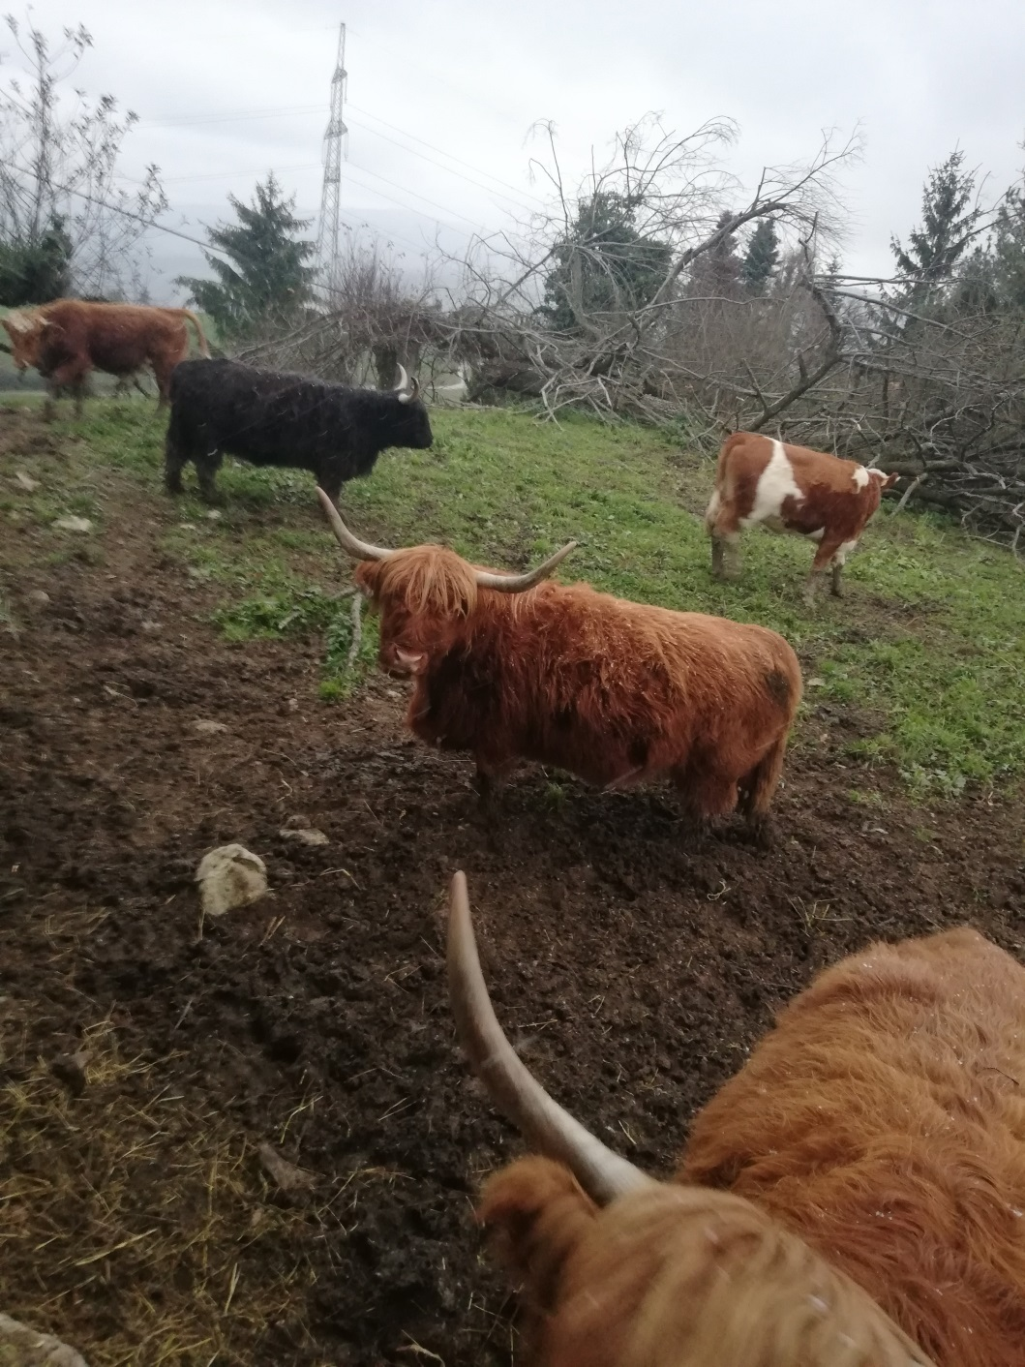

Slide 4
MORNING
I go to the forest or I compose corn and make corncob at home.
If I need to I drive machines to help my father with work.I help him at the forest to slaughter wood for sale and heating.We sale animals too and we go get them to Prekmurje.We buy them there too.
When the sun shines you can see the outlines of the mountins in the distance and castle Bogenšperk which they have for sightseeing.

Slide 5
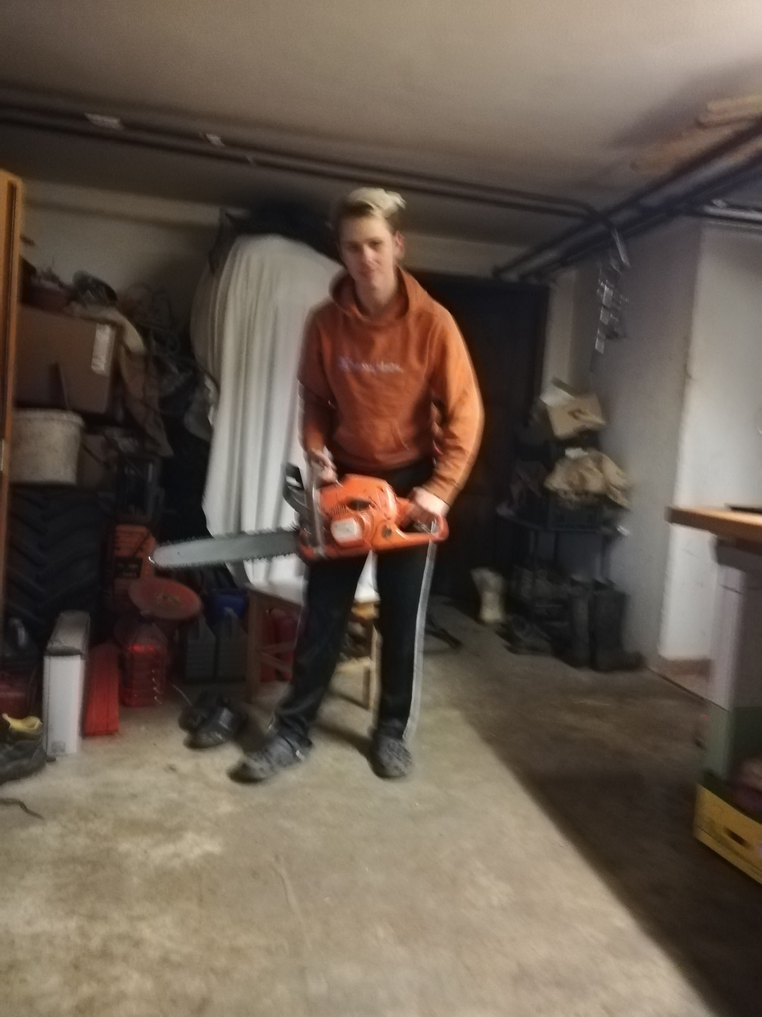
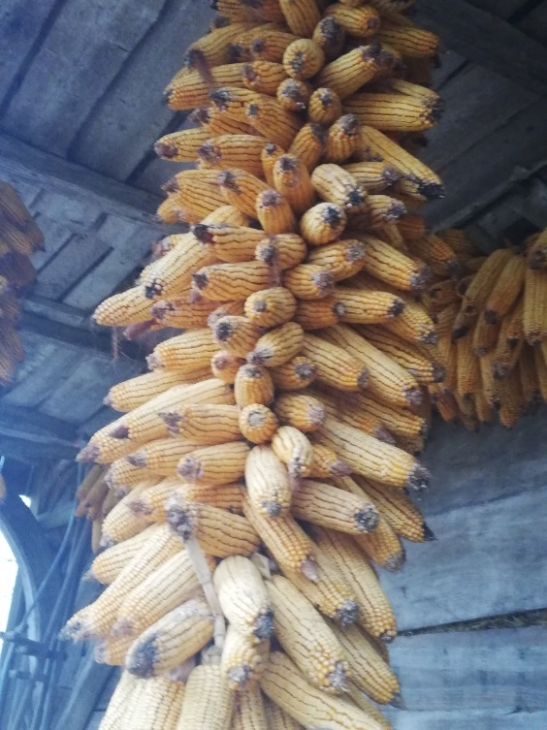
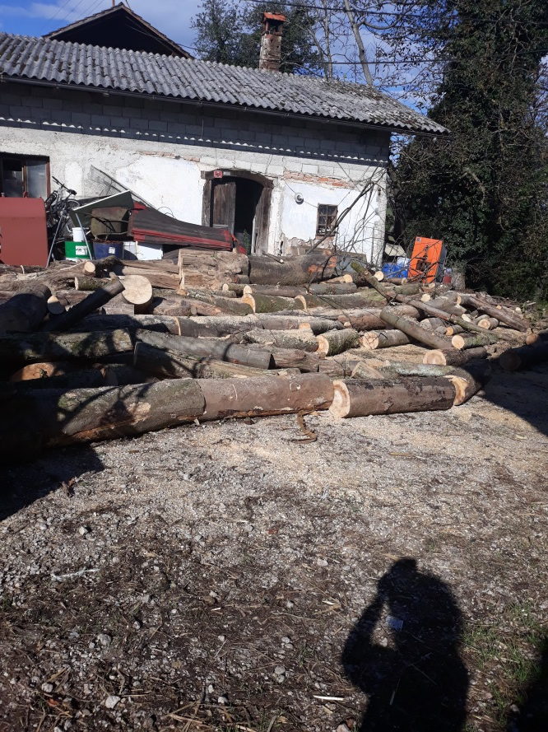

Slide 6
AFTERNOON
We have lunch and after lunch we have to work at stable.
Twice a day we have to go to stable.Becous we have to check that animals have food and water.At 16:00 we go back in stable and do the work.
If it is necessary we cut the grass and immediately give grass away becous than the grass is damaged and it s not god for the animals.
We work at the garden too so we plant vegetable.We have flowers so they decorate surrounding.We have trees that have diffrent kind of fruits like cherries,apples,greengage,plums and pears.We use pears for the juice or wine and apples for nectar.

Slide 7
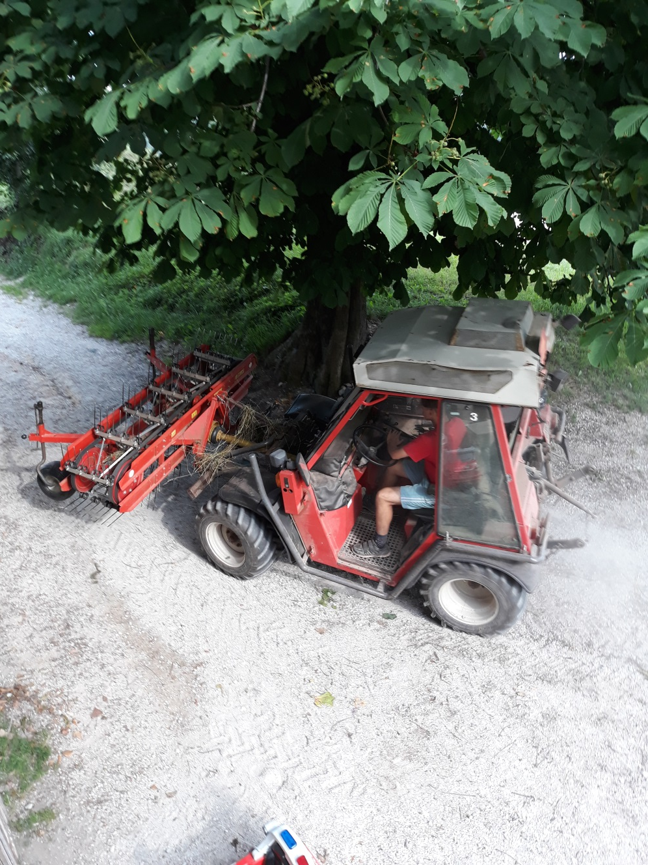
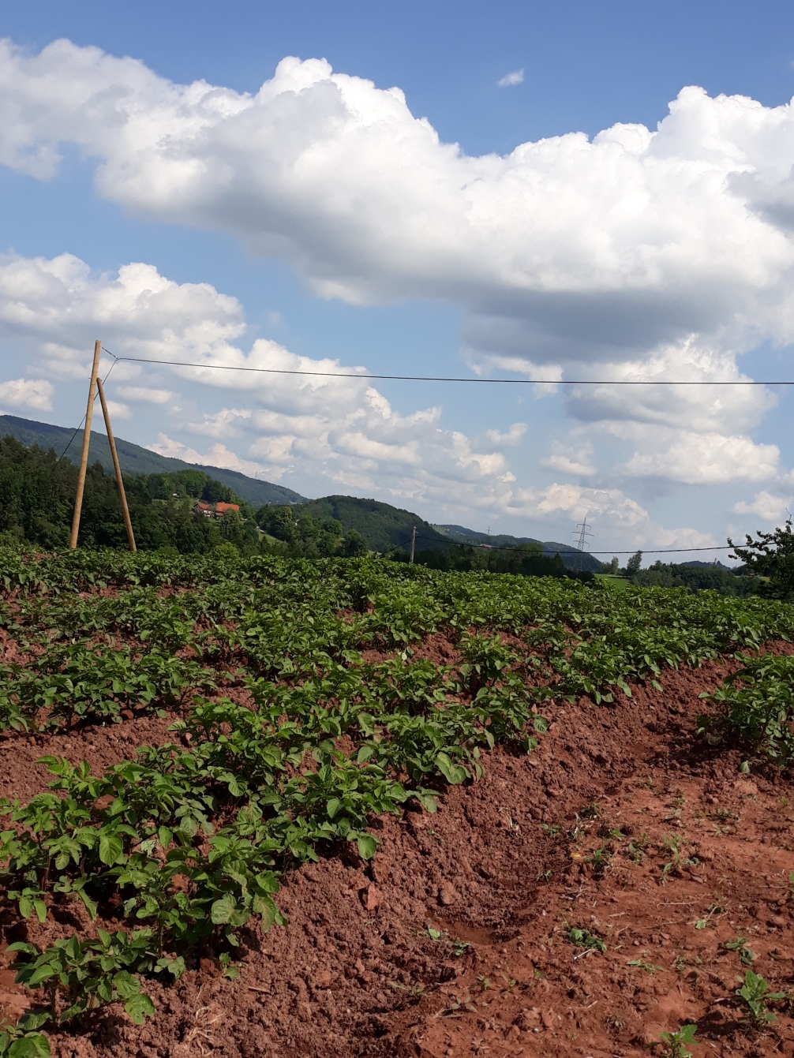

Slide 8
EVENING
When we finish with work,we have to do something inside the house.If we dont find the work in the house we are free.
Then we have dinner after dinner we are preparing for the next day.

Slide 9
